Slide 1
Software Development Methodologies
Krishnaganth R L

Slide 2
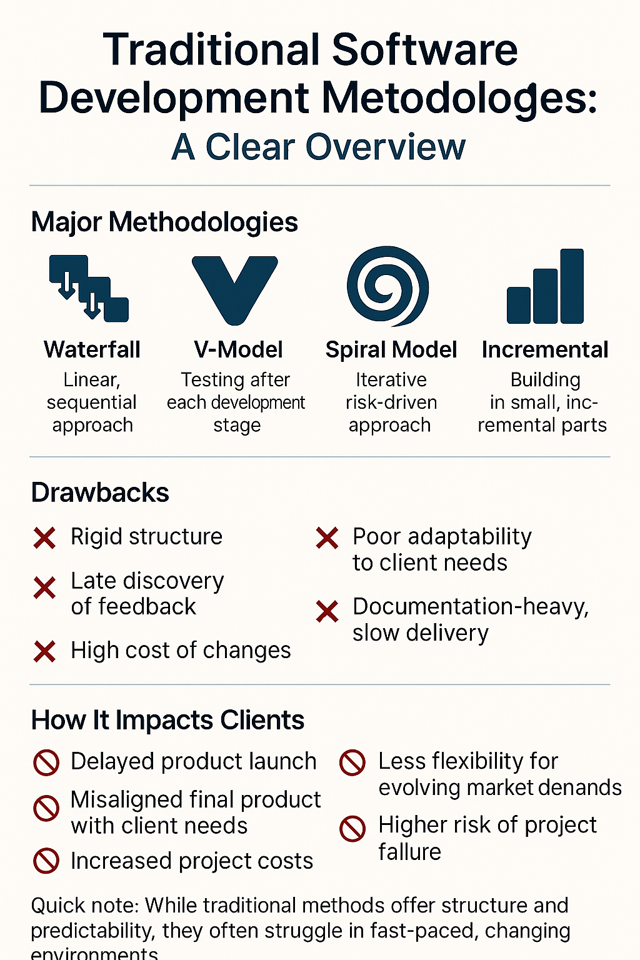
Traditional Methodologies
Types : PRINCE2 Time to use: >Chance of changing features during the project is low. >Great for projects where the deliverables and scope of work are fixed. Eg: Banks, Governments

Slide 3
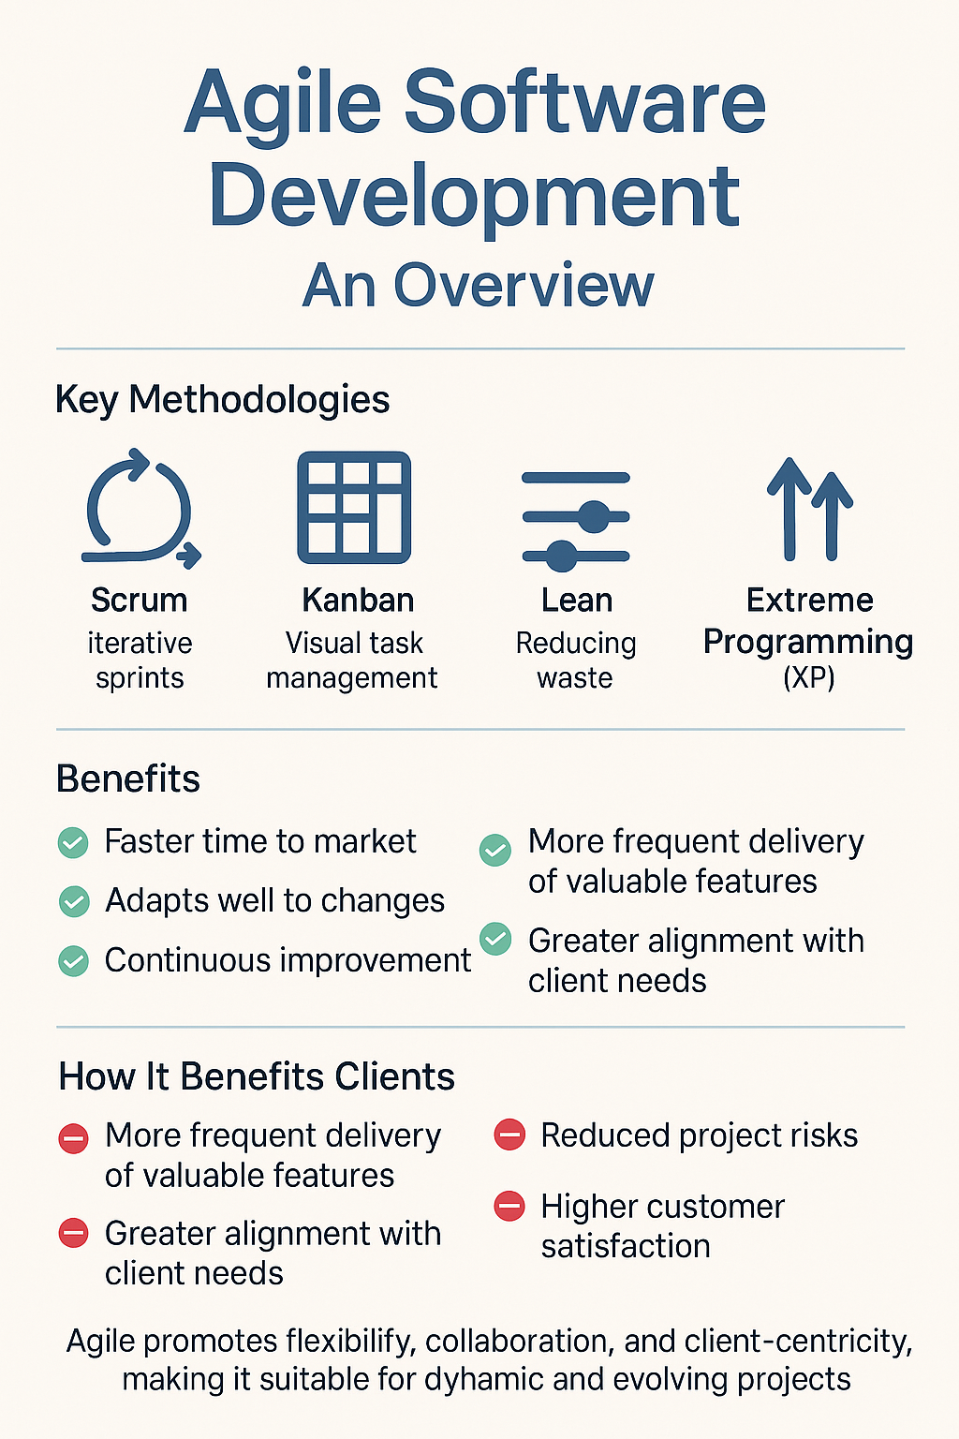
Agile Methodologies
Types: SCRUM, SAFe, LeSS, Nexus, PRINCE2AGILE and Kanban.
Advantages over Traditional: >This approach also allows better estimation of project costs, and the client is already aware of the next implementation steps at the planning stage >Each iteration begins with a summary of the steps already taken and planning of the next steps, and the results of each sprint are presented to the client on an ongoing basis. >MVP (minimum viable product), that is, a version of the product is created with enough features for the first customers to use

Slide 4
THANK YOU

